Slide 1
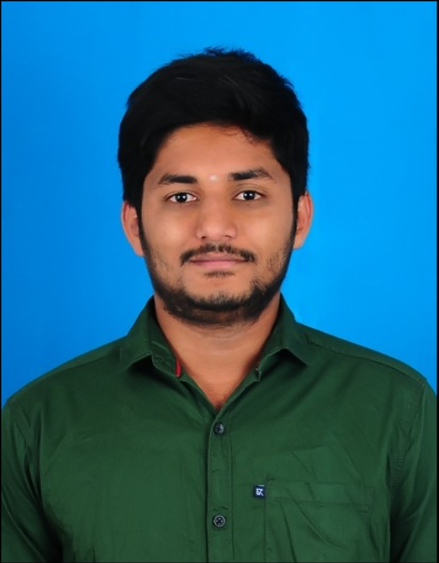

Skills
MuleSoft
Java
Spring Framework
Basics of AWS
SQL
Competencies
Good understanding of mule connectors, flows and their applications. Understanding of API-led connectivity and mule ESB. Ability to comprehend the Business Requirement, Design and proficient in using Any point Platform to build, deploy and manage APIs. Trained on Core Integration Framework(CIF) and Hands on experience with CIF tool. Good understanding in java OOPS Concepts , Exception handling and Collections. Trained on Spring Framework (Spring MVC and Spring BOOT). Creating Airline systems with SQL, Java and Spring Boot Technologies. AWS Level-0 Certified(Migration Ambassador Foundations). Analytical mindset and problem-solving skills. Good communication skills and effective team player.
Hemanth Gowda P
hemanth.gowda-p@capgemini.com
8971535910
MuleSoft Certified
Developer Level 1,
Bachelor’s Degree in
Civil Engineering
Mule Specifics
RAML
Designing API
Standard Connectors
API Manager
Runtime Manager
Any point Platform
Dataweave
Scheduler
Batch processing
Logging
Error Handling
Water Marking
Integration Experience
Working knowledge on error handling and logging, in API-led environment. Used Data weave transformations to handle diverse set of message formats like JSON, XML, CSV, etc. Worked for a Bidirectional sync project to create RAMLs and created its APIs using RAML file. Knowledge of Error handling and batch processing in API led. Working knowledge of batch implementations, to synchronise data between Salesforce and Business Database. Created API’S and deployment on Cloud hub.

